Slide 1
Storage Lab

Slide 2
Lab Architecture

Slide 3
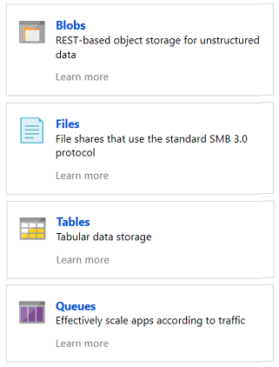
Azure Storage Account
A service that you can use to store files, messages, tables, and other types of information. It is durable, secure, scalable, managed and accessible.
Azure Storage Services:
Azure Blobs: A massively scalable object store for text and binary data
Azure Files: Managed file shares for cloud or on-premises deployments
Azure Tables: A NoSQL store for schema less storage of structured data
Azure Queues: A messaging store for reliable messaging between application components
Notes:
https://docs.microsoft.com/en-us/azure/storage/common/storage-account-overview

Slide 4
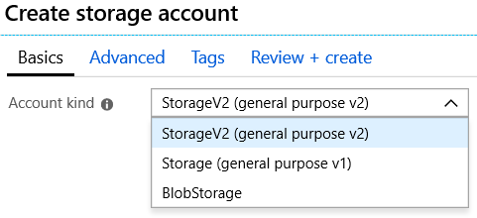
Storage Account Types
Storage V2 – latest version, lowest price, supports all services, recommended
Storage V1 – legacy account
Blob Storage - specialized for storing unstructured object data

Slide 5
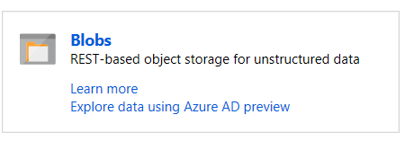
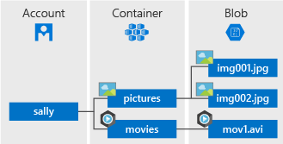
Blob Storage
Stores unstructured data in the cloud
Can store any type of text or binary data
Also referred to as object storage
Common uses:
Serving images or documents directly to a browser
Storing files for distributed access
Streaming video and audio
Storing data for backup and restore, disaster recovery, archiving
Storing data for analysis by an on-premises or Azure-hosted service
Notes:
For more information, you can see:
Azure Blob Storage - https://azure.microsoft.com/en-us/services/storage/blobs/

Slide 6
Redundancy Models
Typically >300mi
Typically >300mi
Zone 1
Zone 2
Zone 3
Async
Async
Primary
Secondary
Primary
Secondary
Geo-redundant storage (GRS)
6 replicas, 2 regions (3/region)
Protects against major regional disasters
Asynchronous to secondary
Read-access Geo-redundant storage (RA-GRS)
GRS + Read access to secondary
Separate secondary endpoint
RPO delay to secondary can be queried
Locally-redundant storage (LRS)
3 replicas, 1 region
Protect against disk, node, rack failures
Write is ack’d when all replicas are committed
Superior to dual-parity RAID
Zone-redundant storage (ZRS) v2
3 replicas across 3 Zones
Protect against disk, node, rack and zone (independent cooling, networking, power) failures
Synchronous writes to all 3 zones

Slide 7
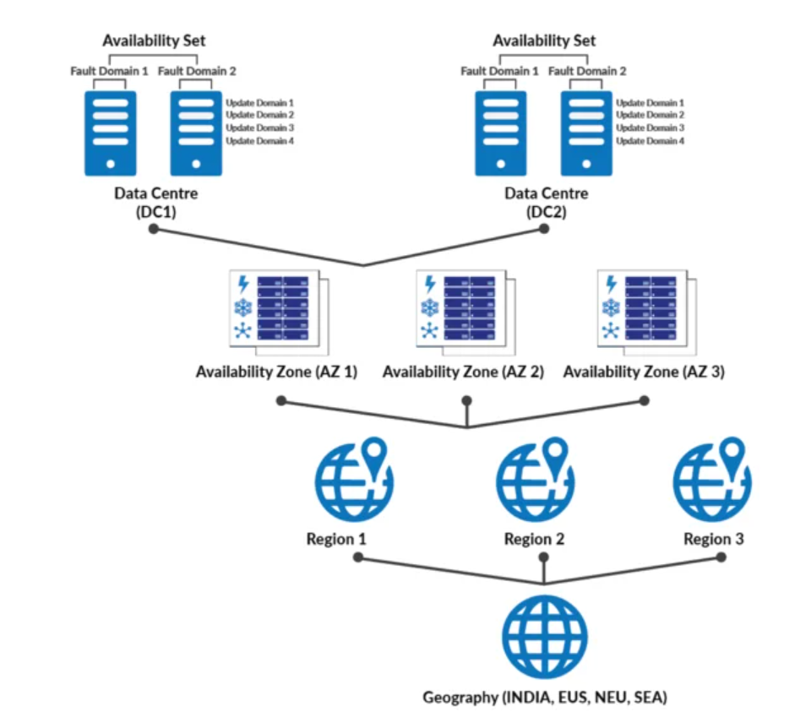
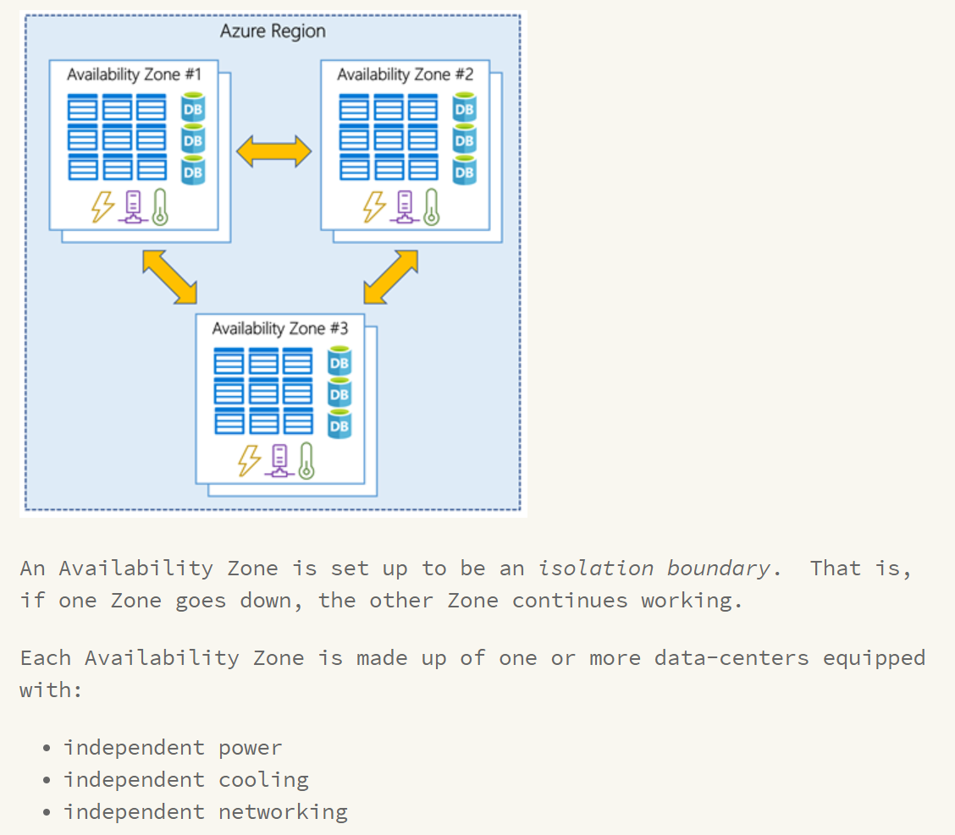
Geography \ Region \ Zone
Notes:
Azure geographies
Each Azure geography contains one or more regions and meets specific data residency and compliance requirements.

Slide 8
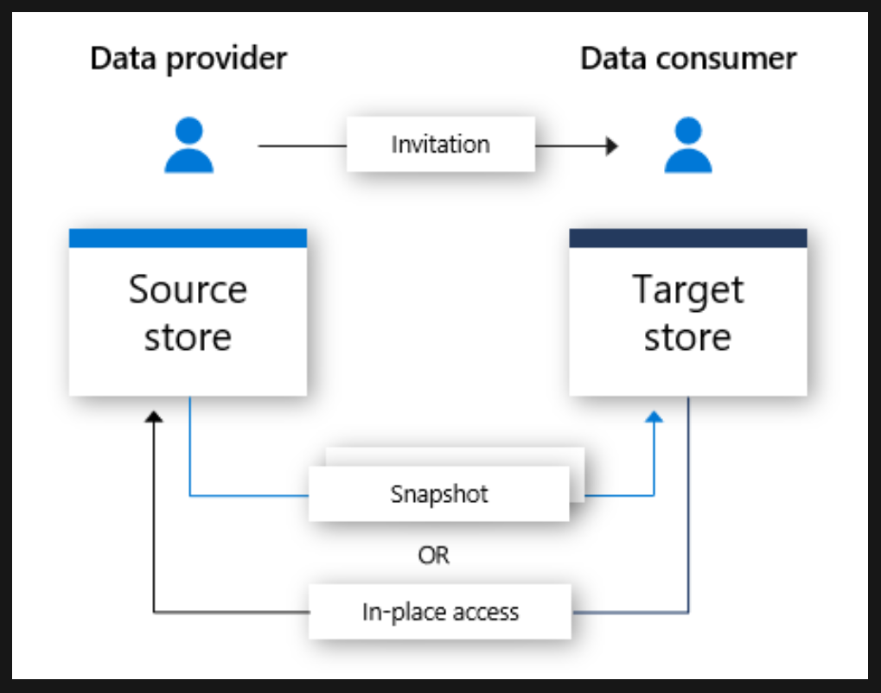
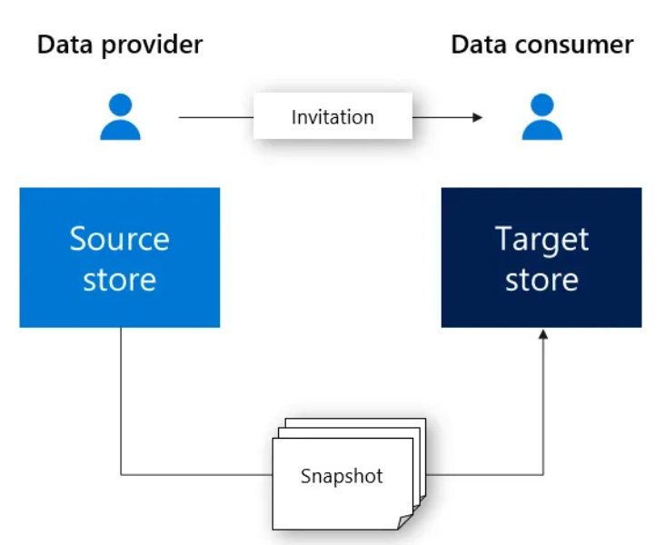
Azure Data Share
Allows you to share data, in any format and any size, from multiple sources with other organizations
Control what you share and who receives your data
No infrastructure to setup or manage
Support snapshot-based sharing (copy) or in-place sharing
Supported Data Sources
Azure Synapse Analytics
Azure SQL Database
Azure Blob Storage
Azure Data Lake Storage
Azure Data Explorer
Notes:
For more information, you can see:
Azure Blob Storage - https://azure.microsoft.com/en-us/services/storage/blobs/
https://docs.microsoft.com/en-us/azure/data-share/overview
Snapshot
A snapshot can be created by a data consumer when they accept a data share invitation. When they accept an invitation, they can trigger a full snapshot of the data shared with them. The snapshot is a copy of the data at the point in time that the data consumer generated the snapshot.
There are two types of snapshots - full and incremental. A full snapshot contains all the data within the data share. An incremental snapshot contains all the data that has been updated/added since the last snapshot was triggered.
How it works
Azure Data Share currently offers snapshot-based sharing and in-place sharing.
In snapshot-based sharing, data moves from the data provider's Azure subscription and lands in the data consumer's Azure subscription. As a data provider, you provision a data share and invite recipients to the data share. Data consumers receive an invitation to your data share via e-mail. Once a data consumer accepts the invitation, they can trigger a full snapshot of the data shared with them. This data is received into the data consumers storage account. Data consumers can receive regular, incremental updates to the data shared with them so that they always have the latest version of the data.
Data providers can offer their data consumers incremental updates to the data shared with them through a snapshot schedule. Snapshot schedules are offered on an hourly or a daily basis. When a data consumer accepts and configures their data share, they can subscribe to a snapshot schedule. This is beneficial in scenarios where the shared data is updated on a regular basis, and the data consumer needs the most up-to-date data.
Support both csv and parquet
In-place Sharing
With in-place sharing, data providers can share data where it resides without copying the data. After sharing relationship is established through the invitation flow, a symbolic link is created between the data provider's source data store and the data consumer's target data store. Data consumer can read and query the data in real time using its own data store. Changes to the source data store is available to the data consumer immediately. In-place sharing is currently in preview for Azure Data Explorer.

Slide 9
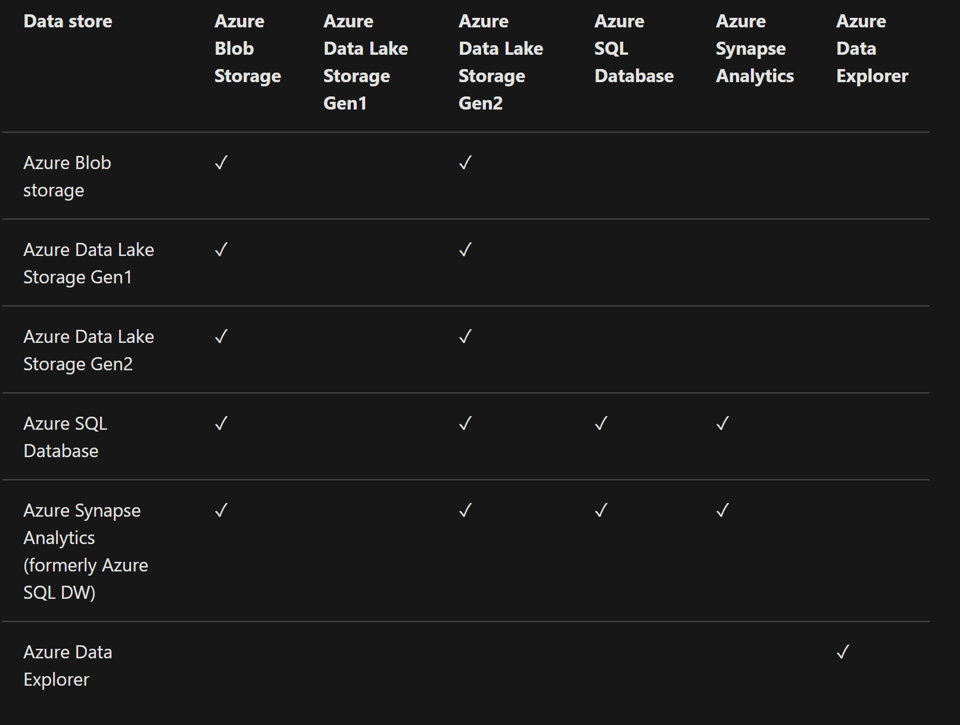
Data store support matrix

Slide 10
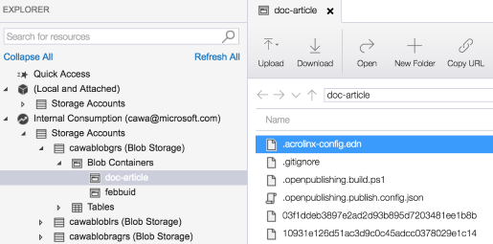
Azure Storage Explorer
Access multiple accounts and subscriptions
Create, delete, view, edit storage resource
View and edit Blob, Queue, Table, File, Cosmos DB storage and Data Lake Storage
Obtain shared access signature (SAS) keys
Available for Windows, Mac, and Linux

Slide 11
Lab Architecture

Slide 12
Other Resources
Azure Storage Account Overview
https://docs.microsoft.com/en-us/azure/storage/common/storage-account-overview
Azure Storage Redundancy Options
https://docs.microsoft.com/en-us/azure/storage/common/storage-redundancy?toc=%2fazure%2fstorage%2fblobs%2ftoc.json
Azure Data Share Documentation
https://docs.microsoft.com/en-us/azure/data-share/
Other Storage Labs
https://docs.microsoft.com/en-us/learn/modules/connect-an-app-to-azure-storage/
https://docs.microsoft.com/en-us/learn/modules/gather-metrics-blob-storage/

